Slide 1
OpenStack Cyborg Work Update
Yikun Jiang

Slide 2
Agenda
Cyborg introdcution
Cyborg journey
Cyborg concept overview
Mainly work in Train release

Slide 3
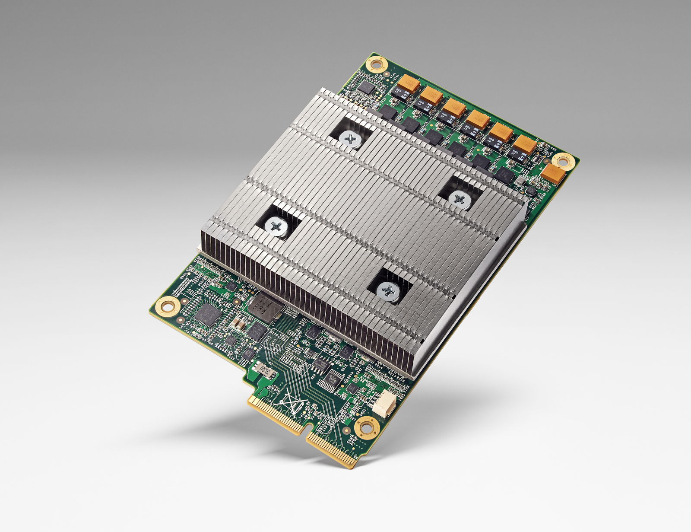
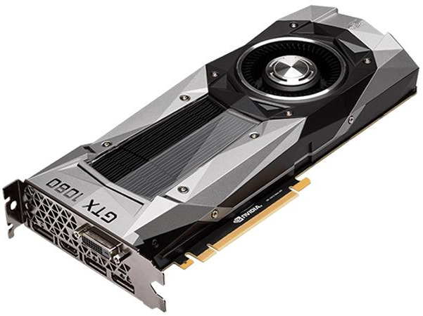
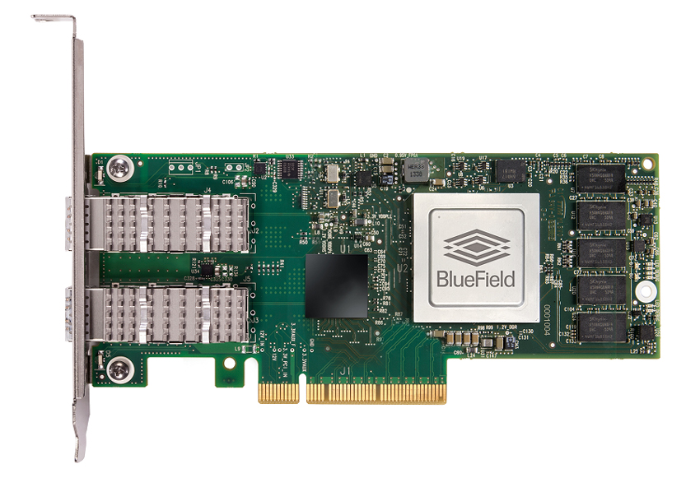
New Era of Domain Specific Architecture
NPU
GPU
SmartNIC/FPGA
Neural network processors for machine learning
GPUs for graphics, virtual reality, ML
Programmable network switches and hardware

Slide 4
How To Manage These DSAs For Cloud ?

Slide 5

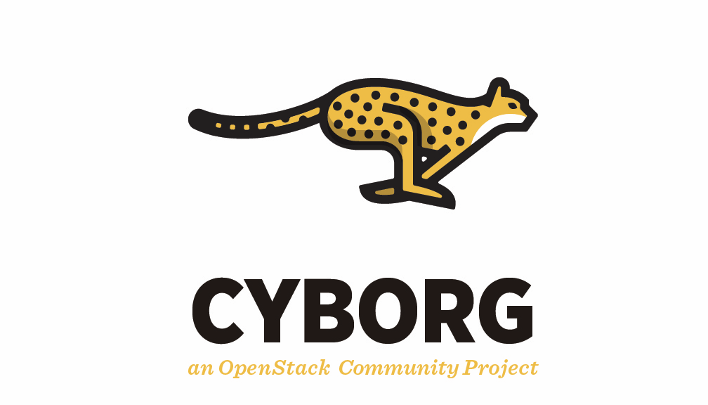
Cyborg is a general management framework for accelerators
Proud OpenStack Official Project since 2017.09 (https://github.com/openstack/cyborg )
Notes:
Cyborg aims to be the lifecycle management for accelerators

Slide 6
An Unbelievable Journey

Slide 7
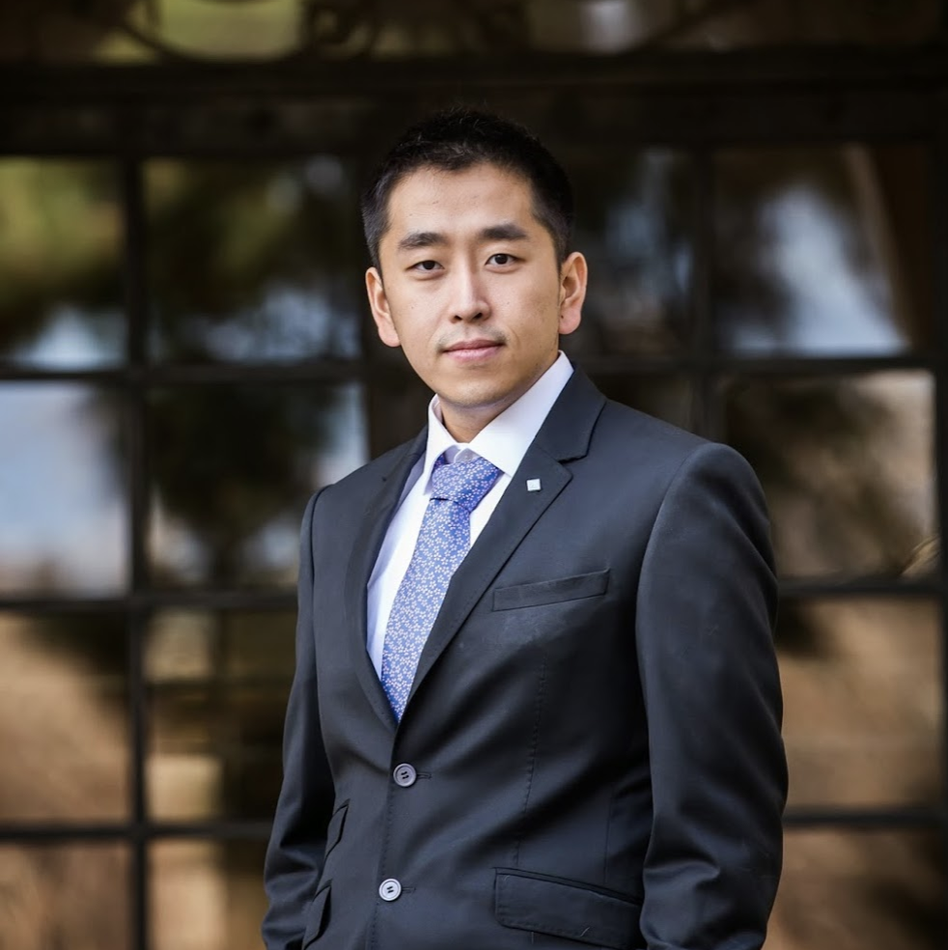
Cyborg’s growth (popularity)
2016 .02- 2017.02

Slide 8
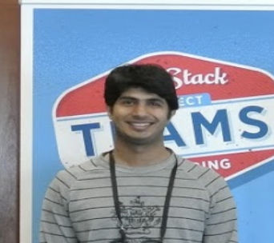
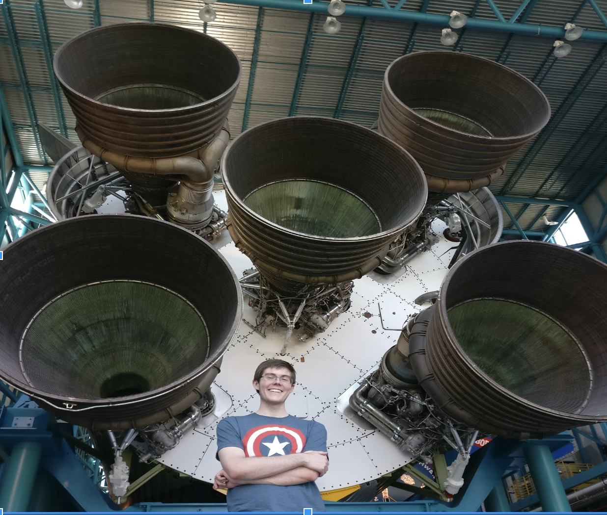
Cyborg’s growth (popularity)
2016 .02- 2017.02
2017 .02- 2017.09

Slide 9
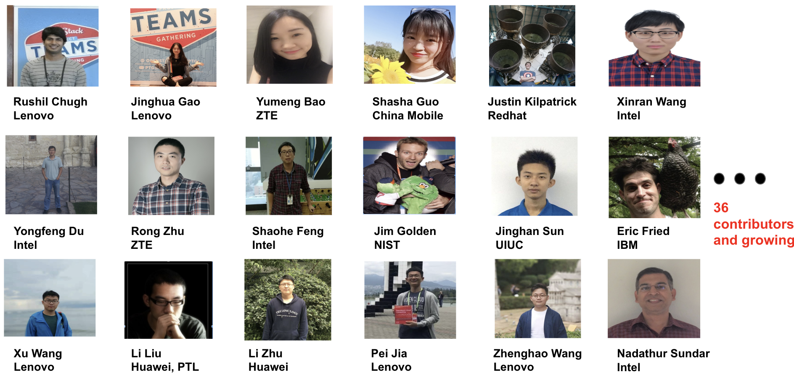
Cyborg’s growth (popularity)
2016 .02- 2017.02
2017 .02- 2017.09
2017 .09- 2019.06

Slide 10
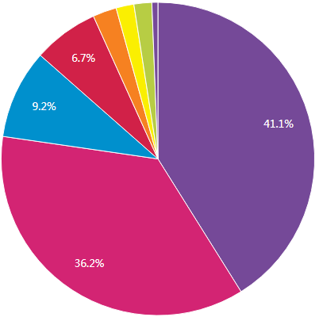
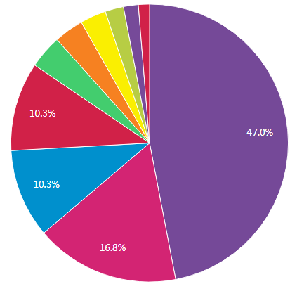
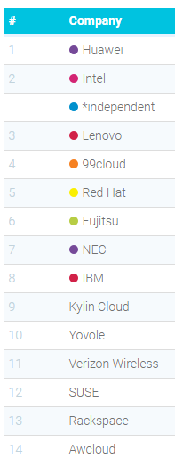
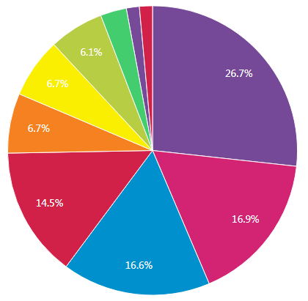
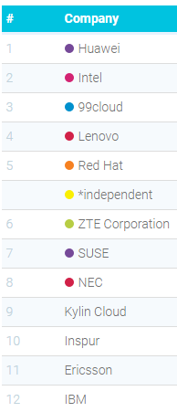
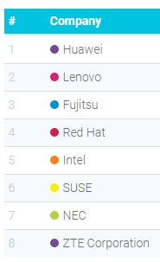
Cyborg’s growth (Diversity)
Q 2018.02
R 2018.08
S 2019.04

Slide 11
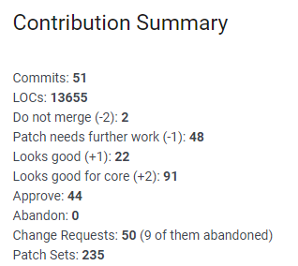
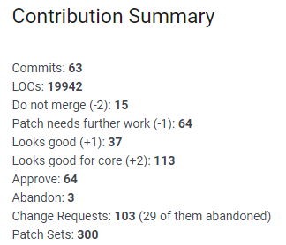
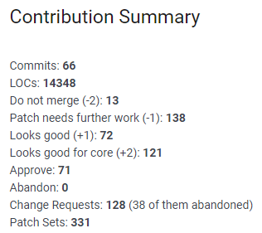
Cyborg’s growth (Maturity)
Q 2018.02
R 2018.08
S 2019.04

Slide 12
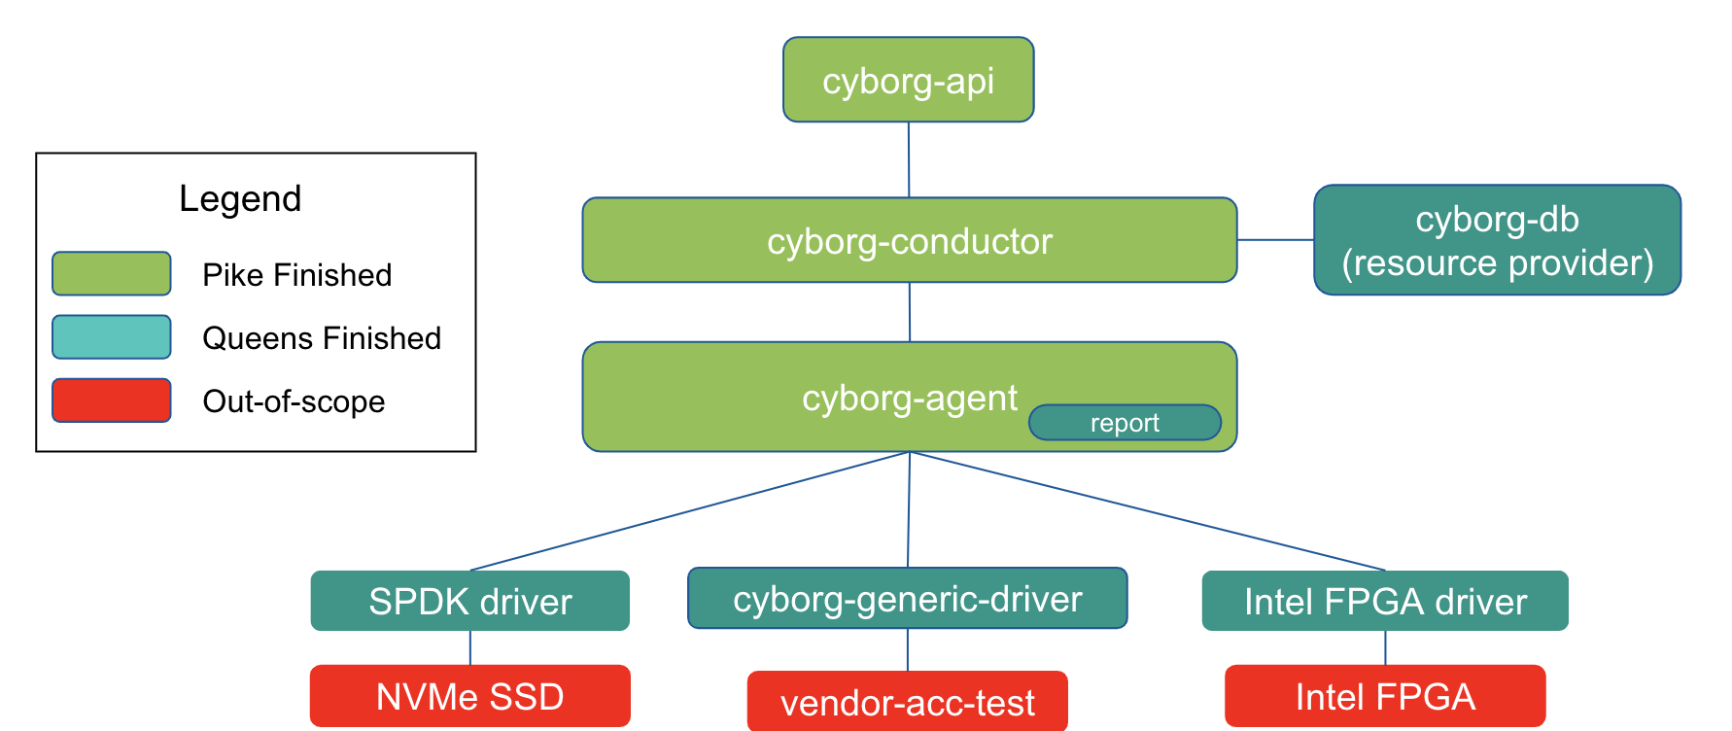
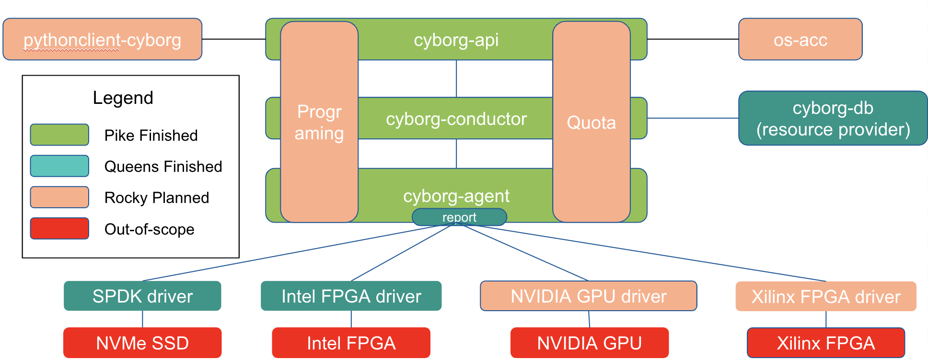
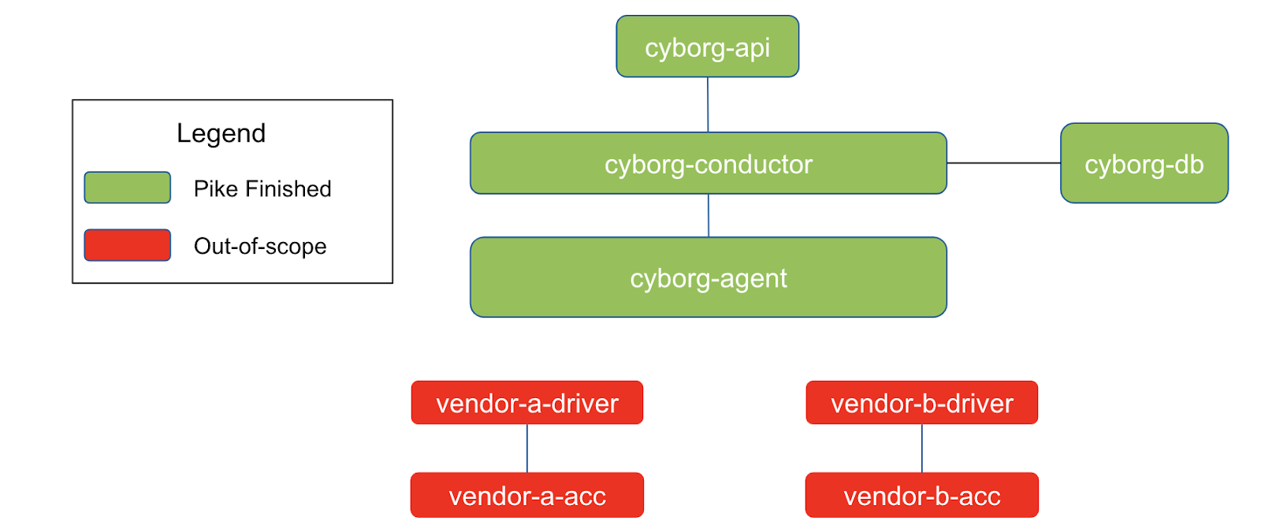
Cyborg’s growth (Arch Evolution)
2017.09
2018.02
2019.04

Slide 13
Cyborg arch overview
Client
cyborg-api
Controller
cyborg-conductor
cyborg-db
Compute Node
cyborg-agent
SPDK driver
FPGA
driver
GPU
driver
AICHIP
driver
NVMe
SSD
FPGA
device
GPU
device
AICHIP
driver

Slide 14
Abstract Device Model
ControlPath ID
Attach Handles
Accelerators
Deployables
Device
Term | Meaning | Placement Represent
Deployable | A logical structure in a device that provides a resource. A resource can be an accelerator, local memory, etc. | Resource Provider
Accelerator | A logical resource to offload computation, etc. | Resource Class Inventory
Device | Physical hardware. E.g. PCI card. Includes board (Flash/BMC). | --
ControlPath ID | Unique identifier to access the device. E.g. PCI PF. | --
Attach Handle | An ID of the handle to attach to an instance. E.g. PCI VF, mdev UUID. | --

Slide 15
Devices discover
Compute Node
VCPU: 16, Mem: 32768
Placement
Cyborg agent
DB
Nova-api
FPGA Resource
Acc: 2
NPU Resource
Acc: 1
Cyborg-api
Cyborg driver
# lspci | grep d100
0c:00.0 Processing accelerators: Device 19e5:d100 (rev 20)
Controller node
Compute node
NPU Device

Slide 16
The mainly work in 2019 (Train Release)
Nova-Cyborg Integration.
Generic Driver Implementation.
Driver improvement and support.
Python 3 migration.
Testing and validation.
https://etherpad.openstack.org/p/cyborg-train-goals

Slide 17
Nova-Cyborg Integration
Rest API
Placement
Cyborg agent
DB
Nova-api
1. Operator can enable or disable drivers
Cyborg-api
# vim /etc/cyborg/cyborg.conf
[agent]
enabled_drivers = huawei_ascend_driver
Cyborg driver
Controller node
Compute node
NPU Device

Slide 18
Nova-Cyborg Integration
Rest API
Placement
Cyborg agent
DB
Nova-api
2. Operator defines device profiles
(accelerator flavor)
Cyborg-api
{"name": “ascend-aichip",
"groups": [
{"resources:ACCELERATOR_ASCEND": "1",
"trait:AICHIP_ASCEND": "required“
}
]}
Cyborg driver
Controller node
Compute node
NPU Device

Slide 19
Nova-Cyborg Integration
Rest API
Placement
Cyborg agent
DB
Nova-api
3. Operator sets device profiles in compute flavor
Cyborg-api
Cyborg driver
$ openstack flavor set --property \
“accel:device_profile_name=ascend-aichip” \
ascend-flavor
Controller node
Compute node
NPU Device

Slide 20
Nova-Cyborg Integration
Rest API
⑤
Placement
Nova-compute
④
Cyborg agent
Nova-api
Nova-sch
③
Cyborg driver
4. User requests vm with a flaovr
Cyborg
②
Nova-cond
①
$ openstack boot server –-flavor ascend-flavor vm-with-ascend
NPU Device

Slide 21
The key flow of nova-cyborg interaction
Nova
Placement
Cyborg
Nova Compute
GET /v2/device_profiles?name=mydp
GET /allocation_candidates
Select a candidate
Build and run instance
post accelerator_request
patch accelerator_request
POST /os-server-external-events
Wait for event notification
get accelerator_request?
instance=$uuid&bind_state=resolved

Slide 22
Generic driver
In order to easy to add the support for the common accelerator, we propose to improve the generic driver to manage these devices.
[1] https://github.com/openstack/cyborg/blob/master/cyborg/accelerator/drivers/generic_driver.py
class GenericDriver(object):
# Discover a specified accelerator.
def discover(self):
# Update the device firmware with specific image.
def update(self, control_path, image_path)
# Collects device stats
def get_stats(self):
What we want to be done
class FPGADriver(GenericDriver)
class GPUDriver(GenericDriver)
class NPUDRIVER(GenericDriver)
class FakeDRIVER(GenericDriver)

Slide 23
Driver improve and support
FPGA Driver
Nvidia GPU Driver
（New）Huawei Ascend Driver
（New）Intel Movidius Driver

